Slide 1
Contents
Challenges for cloud computing.
Architectural styles for cloud applications.
Workflows - coordination of multiple activities.
Coordination based on a state machine model.-Zookeeper
The MapReduce programming model.

Slide 2
Chapter 4/7 – Cloud Computing Applications and Paradigms

Slide 3
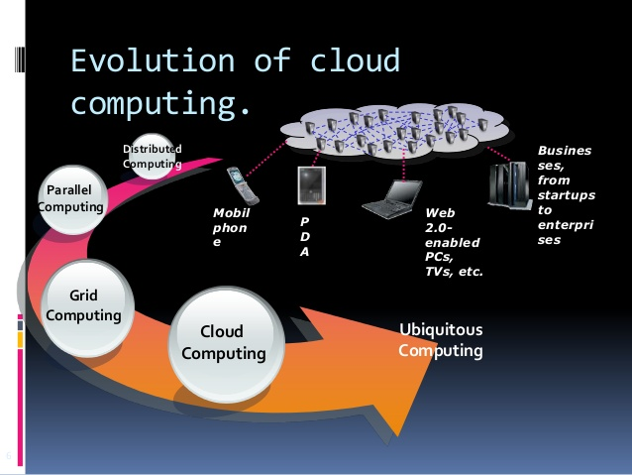

Slide 4
Cloud applications
Cloud computing is very attractive to the users:
Economic reasons.
low infrastructure investment.
low utility based computing.
Convenience and performance.
Parallelization of application.
just-in-time infrastructure
Cloud elasticity
Cloud computing is also beneficial for the providers of computing cycles

Slide 5
Contents
Challenges for cloud computing.
Architectural styles for cloud applications.
Workflows - coordination of multiple activities.
Coordination based on a state machine model.
The MapReduce programming model.

Slide 6
Cloud applications (cont’d)
Ideal applications for cloud computing:
Web services.
Database services.
Transaction-based service.
Applications unlikely to perform well on a cloud:
High-performance computing
complex workflow and multiple dependencies.
intensive communication among concurrent instances.
When the workload cannot be arbitrarily partitioned.

Slide 7
Challenges for cloud application development
Performance isolation.
Security isolation.
Reliability.
Internode latency and bandwidth fluctuations.
Data storage critical.
Performance considerations limit the amount of data logging.

Slide 8
Why Workflows?
Cloud computing enables less investment on infrastructure→ Utitlity Based Computing Costs
It further lowers down the cost if it reduces the execution time of compute intensive application & data intensive application through parallelization.
If an application divide the workload into ‘n’ segment ,spawn ‘n’ instances of itself ,it reduces the execution time by factor close to ‘n’

Slide 9
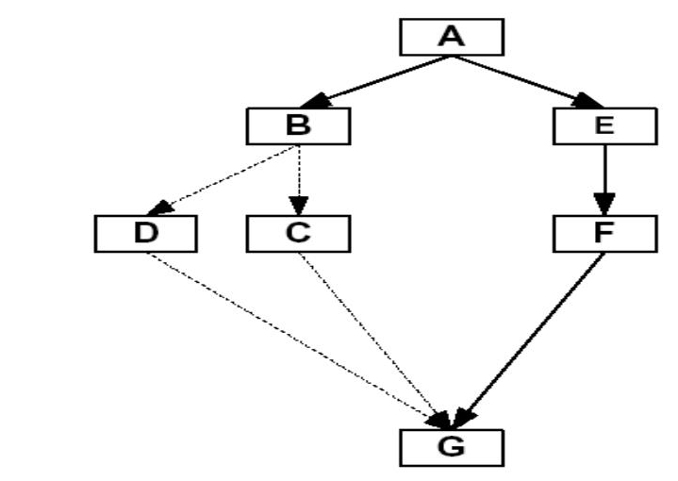
Example of Workflow

Slide 10
Definition Workflow
Description of complex activity involving ensemble of multiple independent tasks is known as workflow.
Workflow models
Life cycle of Workflow
Desirable properties of Workflow Description
Workflow Patterns
Reachability of goal state of workflow
Dynamic workflow

Slide 11
Workflow models
Task –central concept in workflow modelling
Attributes of task
Name
Description
Actions
Preconditions
Post-conditions
Exceptions

Slide 12
Types of Task
Composite Task
Primitive task
Routing task
Fork routing task
Join routing task
Process Description/ Workflow schema

Slide 13
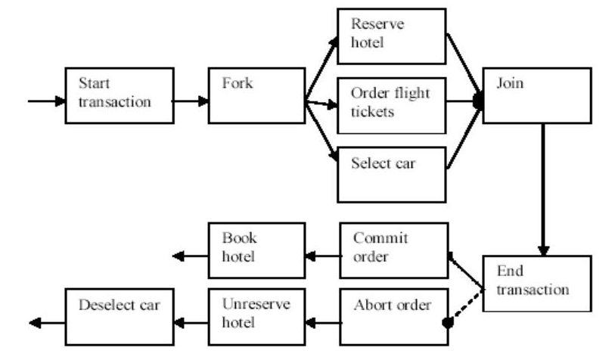

Slide 14
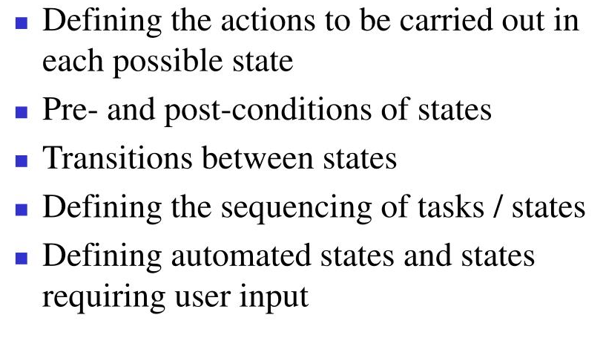
WorkFlow Definition Language

Slide 15
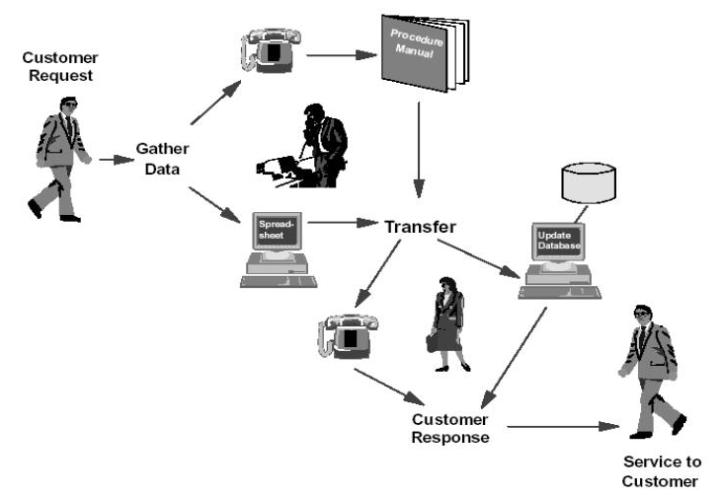
Example of Business Process

Slide 16
Life Cycle of Workflows
Phases in Life Cycle of Workflows
Creation
Definition
Verification
Enactment

Slide 18
Life Cycle of Workflows
Process description - structure describing the tasks to be executed and the order of their execution. Resembles a flowchart.
Case - an instance of a process description.
State of a case at time t - defined in terms of tasks already completed at that time.
Events - cause transitions between states.
The life cycle of a workflow - creation, definition, verification, and enactment; similar to the life cycle of a traditional program (creation, compilation, and execution).

Slide 19
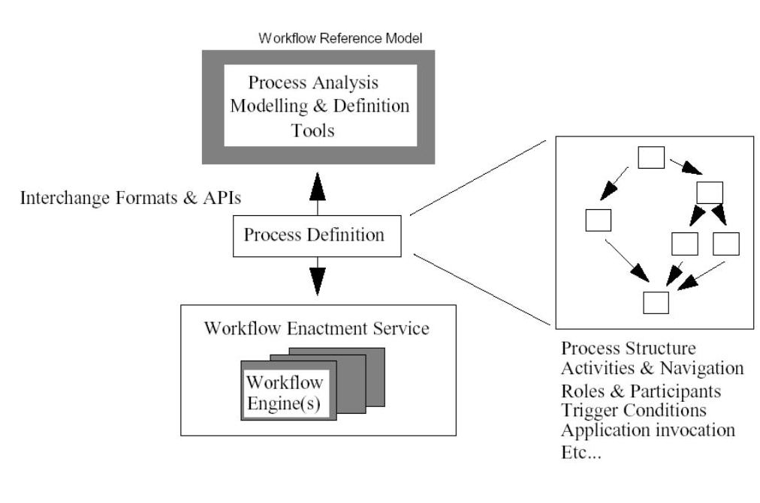

Slide 20
Safety and liveness
Desirable properties of workflows.
Safety → nothing “bad” ever happens.
Liveness → something “good” will eventually happen.

Slide 21
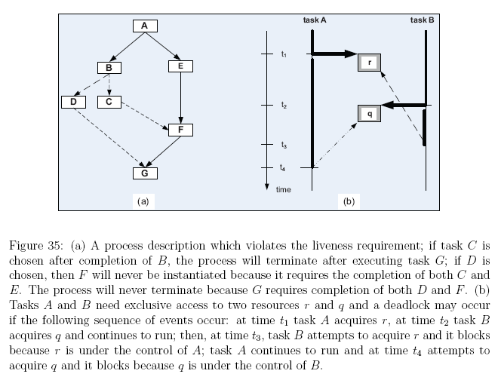

Slide 22
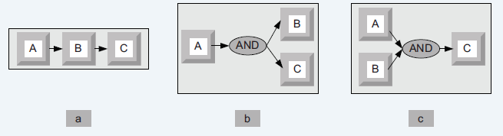
Basic workflow patterns
Workflow patterns - the temporal relationship among the tasks of a process
Sequence - several tasks have to be scheduled one after the completion of the other.
AND split - both tasks B and C are activated when task A terminates.
Synchronization - task C can only start after tasks A and B terminate.

Slide 23
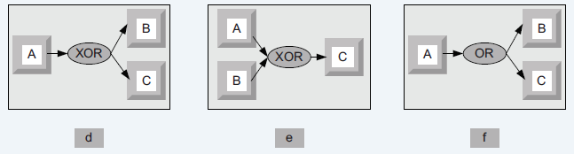
Conti…
XOR split - after completion of task A, either B or C can be activated.
XOR merge - task C is enabled when either A or B terminate.
OR split - after completion of task A one could activate either B, C, or both.

Slide 24
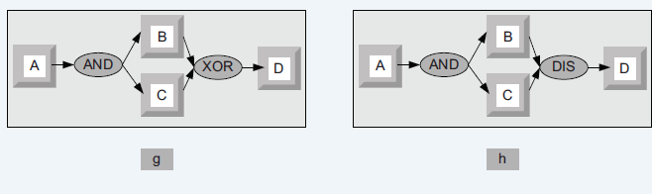
Conti…
Multiple Merge - once task A terminates, B and C execute concurrently; when the first of them, say B, terminates, then D is activated; then, when C terminates, D is activated again.
Discriminator – wait for a number of incoming branches to complete before activating the subsequent activity; then wait for the remaining branches to finish without taking any action until all of them have terminated. Next, resets itself.

Slide 25
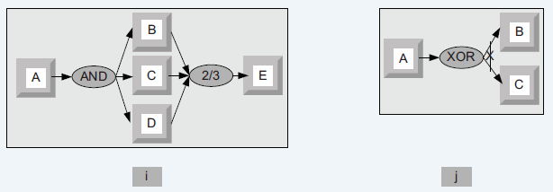
Basic workflow patterns (cont’d)
N out of M join - barrier synchronization. Assuming that M tasks run concurrently, N (N<M) of them have to reach the barrier before the next task is enabled. In our example, any two out of the three tasks A, B, and C have to finish before E is enabled.
Deferred Choice - similar to the XOR split but the choice is not made explicitly; the run-time environment decides what branch to take.

Slide 27
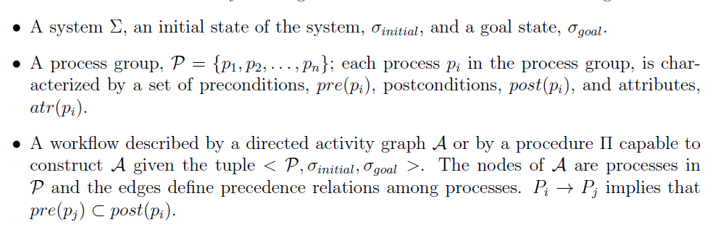
Reachability of goal state

Slide 28
Static & Dynamic workflow
Static workflow: activity graph does not change during the enactment of a case.
Static workflows can be described in WFDL (the workflow definition language),
Dynamic workflow: activity graph to be modified during the enactment of a case.
Need a more flexible approach.
Strong coordination models
Weak coordination models

Slide 29
Coordination - ZooKeeper
Cloud elasticity → distribute computations and data across multiple systems; coordination among these systems is a critical function in a distributed environment.
ZooKeeper
Distributed coordination service for large-scale distributed systems.
High throughput and low latency service.
Open-source software written in Java with bindings for Java and C.
The servers in the pack communicate and elect a leader.
A database is replicated on each server; consistency of the replicas is maintained.
A client connect to a single server, synchronizes its clock with the server, and sends requests, receives responses and watch events through a TCP connection.

Slide 30
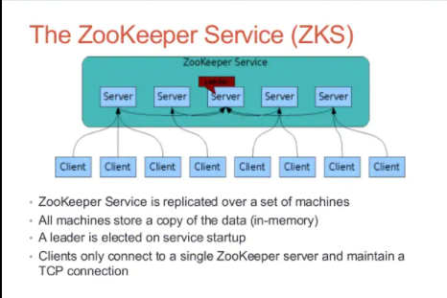

Slide 31
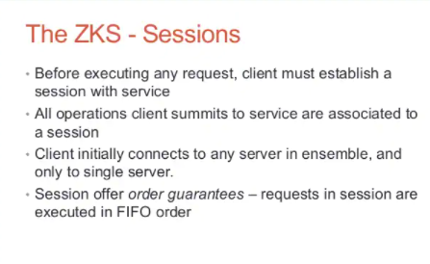

Slide 33
Shared hierarchical namespace similar to a file system; znodes instead of inodes

Slide 34
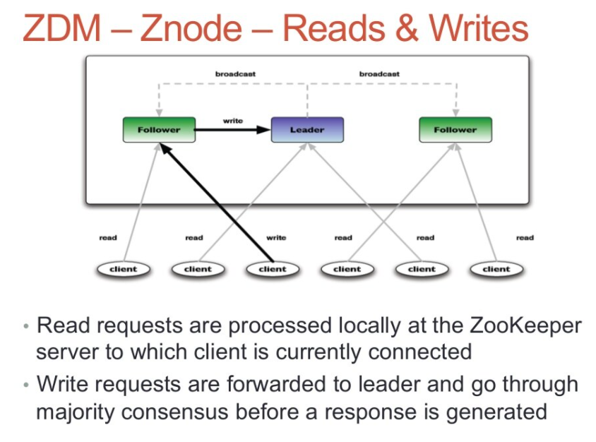

Slide 35
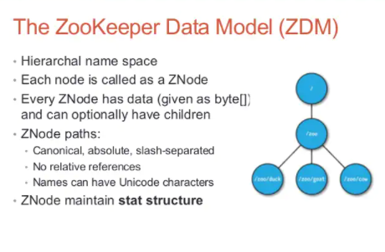
Notes:
Apache Zookeeper (slideshare.net)

Slide 36
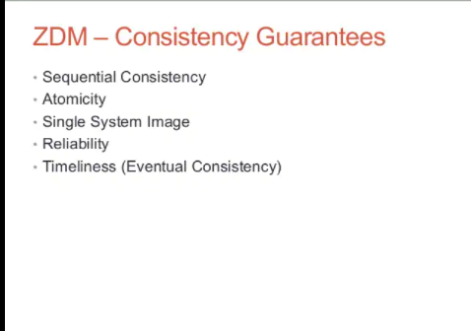

Slide 37
ZooKeeper service guarantees
Atomicity - a transaction either completes or fails.
Sequential consistency of updates - updates are applied strictly in the order they are received.
Single system image for the clients - a client receives the same response regardless of the server it connects to.
Persistence of updates - once applied, an update persists until it is overwritten by a client.
Reliability - the system is guaranteed to function correctly as long as the majority of servers function correctly.

Slide 38
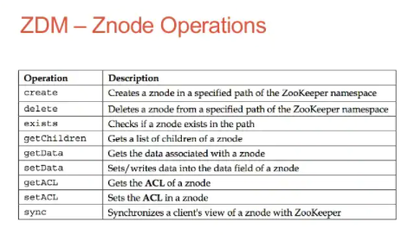
Notes:
ZooKeeper Programmer's Guide (apache.org)

Slide 39
Zookeeper API
The API is simple - consists of seven operations:
Create - add a node at a given location on the tree.
Delete - delete a node.
Get data - read data from a node.
Set data - write data to a node.
Get children - retrieve a list of the children of the node.
Synch - wait for the data to propagate.

Slide 40
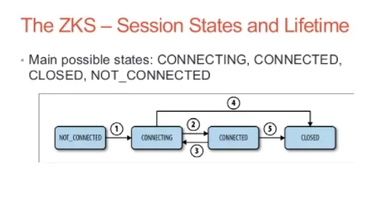

Slide 41
Elasticity and load distribution
Elasticity → ability to use as many servers as necessary to optimally respond to cost and timing constraints of an application.
Two types of divisible workloads are possible:
modularly divisible → the workload partitioning is defined a priori.
arbitrarily divisible → the workload can be partitioned into an arbitrarily large number of smaller workloads of equal, or very close size.

Slide 42
MapReduce philosophy
An application starts a master instance, M worker instances for the Map phase and later R worker instances for the Reduce phase.
The master instance partitions the input data in M segments.
Each map instance reads its input data segment and processes the data.
The results of the processing are stored on the local disks of the servers where the map instances run.

Slide 44
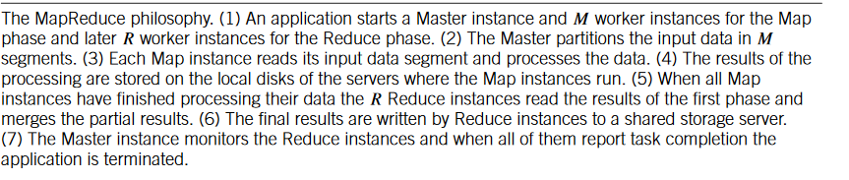

Slide 45
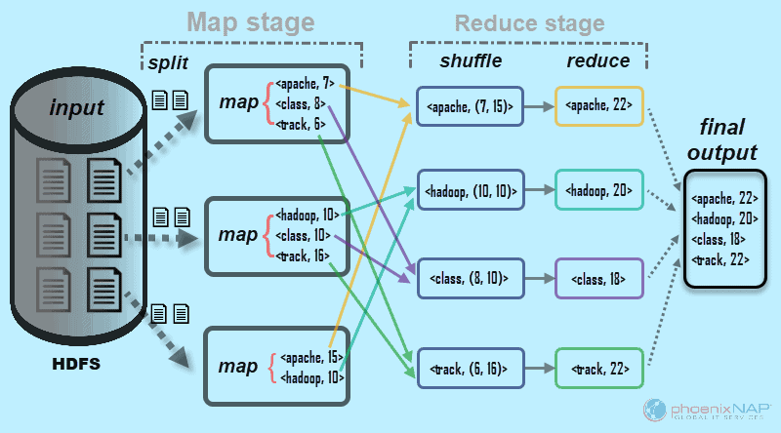

Slide 46
Chunk of Data
What percentage of your user base where talking about games?
“Hi, how are you” “We love football” “He is an awesome football player” “Merry Christmas” “Olympics will be held in China” “Records broken today in Olympics” “Yes, we won 2 Gold medals” “He qualified for Olympics”
Notes:
DGEMM: benchmark which measure floating-point performance of processor/core.
Stream:-measure memory bandwidth.
The network latency benchmark
The network bandwidth benchmark.
PTRANS:- parallel matrix transpose exercises the communication wherby pairs of processors communicate with each other simultaneously.
FFTE:- measure floating point rate of execution of double precision complex one-dimensional Discrete Fourier Transform(DFT).
HPL:-
\

Slide 47
MapReduce philosophy
When all map instances have finished processing their data, the R reduce instances read the results of the first phase and merge the partial results.
The final results are written by the reduce instances to a shared storage server.
The master instance monitors the reduce instances and when all of them report task completion the application is terminated.

Slide 48
Mapping Phase
1. Declare a function “Map” 2. Loop: For each words equal to “football” 3. Increment counter 4. Return key value “football”=>counter
In the same way, we can define n number of mapping functions for mapping various words words: “Olympics”, “Gold Medals”, “cricket”, etc.

Slide 49
Reducing Phase
Input from three mappers in form of key value pair and then processing it.
So, input to the reduce function will look like the following:
reduce(“football”=>2)
reduce(“Olympics”=>3)
reduce(“Gold Medal”=>1)
Algo. for reduce function
Declare a function reduce to accept the values from map function.
Where for each key-value pair, add value to counter.
Return “games”=> counter.
we will get the output like “games”=>6
Notes:
MapReduce Algorithms | A Concise Guide to MapReduce Algorithms (educba.com)

Slide 50
OVERVIEW
Cloud Support Different Architecture for Client-Server Communication.
How Cloud support Coordination of multiple activity using ZooKeeper.
How Cloud supports Elasticity and division of workloads.

Slide 51
USEFULL LINKS
https://www.youtube.com/watch?v=dwTlW_HrsVg

